Slide 1
Chapter 10 Thinking in Objects

Slide 2
Wrapper Classes
Boolean
Character
Short
Byte
Integer
Long
Float
Double
NOTE: (1) The wrapper classes do not have no-arg constructors. (2) The instances of all wrapper classes are immutable, i.e., their internal values cannot be changed once the objects are created.

Slide 3
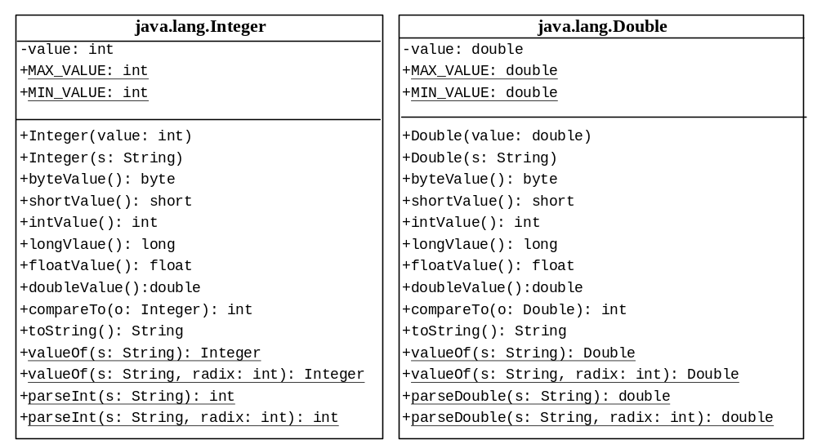
The Integer and Double Classes

Slide 4
The Integer Class and the Double Class
Constructors
Class Constants MAX_VALUE, MIN_VALUE
Conversion Methods

Slide 5
Numeric Wrapper Class Constructors
You can construct a wrapper object either from a primitive data type value or from a string representing the numeric value. The constructors for Integer and Double are:
  public Integer(int value)
  public Integer(String s)
  public Double(double value)
  public Double(String s)

Slide 6
Numeric Wrapper Class Constants
Each numerical wrapper class has the constants MAX_VALUE and MIN_VALUE. MAX_VALUE represents the maximum value of the corresponding primitive data type. For Byte, Short, Integer, and Long, MIN_VALUE represents the minimum byte, short, int, and long values. For Float and Double, MIN_VALUE represents the minimum positive float and double values. The following statements display the maximum integer (2,147,483,647), the minimum positive float (1.4E-45), and the maximum double floating-point number (1.79769313486231570e+308d).

Slide 7
Conversion Methods
Each numeric wrapper class implements the abstract methods doubleValue, floatValue, intValue, longValue, and shortValue, which are defined in the Number class. These methods “convert” objects into primitive type values.

Slide 8
The Static valueOf Methods
The numeric wrapper classes have a useful class method, valueOf(String s). This method creates a new object initialized to the value represented by the specified string. For example:
  Double doubleObject = Double.valueOf("12.4");
  Integer integerObject = Integer.valueOf("12");

Slide 9
The Methods for Parsing Strings into Numbers
You have used the parseInt method in the Integer class to parse a numeric string into an int value and the parseDouble method in the Double class to parse a numeric string into a double value. Each numeric wrapper class has two overloaded parsing methods to parse a numeric string into an appropriate numeric value.

Slide 10
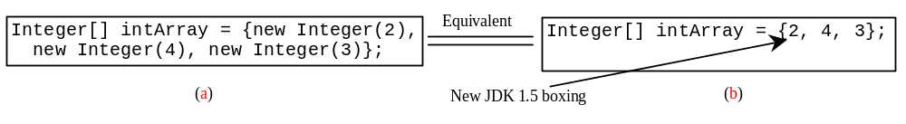
Automatic Conversion Between Primitive Types and Wrapper Class Types
JDK 1.5 allows primitive type and wrapper classes to be converted automatically. For example, the following statement in (a) can be simplified as in (b):
Integer[] intArray = {1, 2, 3};
System.out.println(intArray[0] + intArray[1] + intArray[2]);
Unboxing

Slide 11
BigInteger and BigDecimal
If you need to compute with very large integers or high precision floating-point values, you can use the BigInteger and BigDecimal classes in the java.math package. Both are immutable. Both extend the Number class and implement the Comparable interface.

Slide 12
BigInteger and BigDecimal
BigInteger a = new BigInteger("9223372036854775807");
BigInteger b = new BigInteger("2");
BigInteger c = a.multiply(b); // 9223372036854775807 * 2
System.out.println(c);
LargeFactorial
Run
BigDecimal a = new BigDecimal(1.0);
BigDecimal b = new BigDecimal(3);
BigDecimal c = a.divide(b, 20, BigDecimal.ROUND_UP);
System.out.println(c);

